Slide 1
Heritage and Identity
Communities in Canada Past and Present
Jacqueline Boehme
Jenna Cook
Naomi Peaker
Notes:
Jacq

Slide 2
Grade 6 Overview
What Else You Could Do!
This strand of Social Studies allows for a great deal of critical thinking by students and could be developed into many different units
Students already have a strong foundation in Social Studies content and are ready to face more challenging concepts
Many issues discussed in this strand may be sensitive for students, it is important to place a focus on the Citizenship Framework
Notes:
Jacq

Slide 3
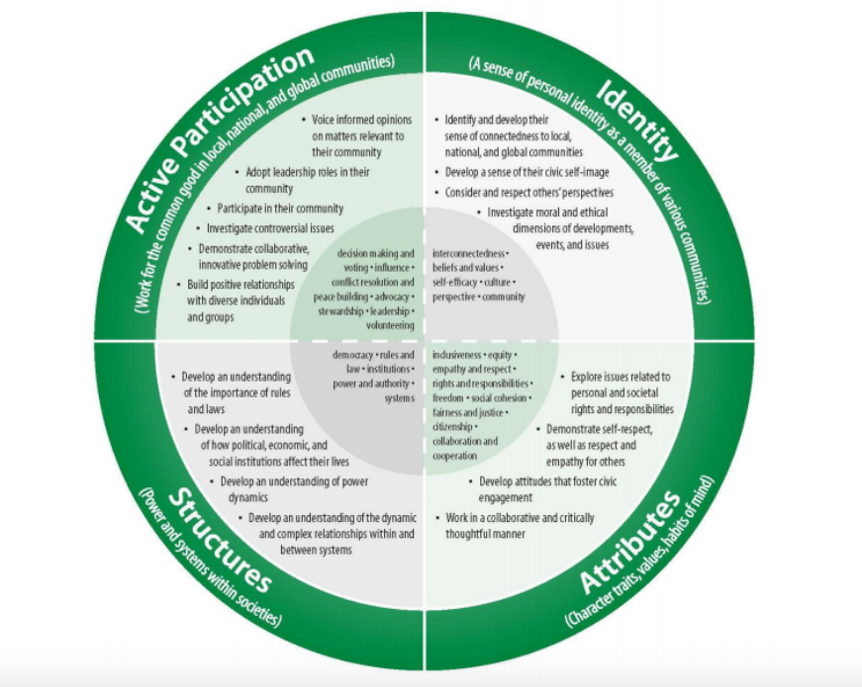
Grade 6 Overview
What Else You Could Do!
Notes:
Jacq

Slide 4
Prior Knowledge
Further Knowledge
Grade 1: People and Environments: The Local Community
Grade 2: Heritage and Identity: Changing Family and Community Traditions
Grade 3: Heritage and Identity: Communities in Canada, 1780-1850
Grade 5: Heritage and Identity: First Nations and Europeans in New France and Early Canada
Grade 7: Canada, 1800-1850: Conflict and Challenges
Grade 8: Creating Canada, 1850-1890
Grade 8: Canada, 1890-1914: A Changing Society
Notes:
Jenna

Slide 5
Lesson 1: Canadian Identity & Symbols
Lesson 2: Past of First Nations
Lesson 3: FNMI: Elder Experiences
Lesson 4: Inclusiveness in the 20th Century
Lesson 5: Multiculturalism
Lesson 6: Heritage Minute
Unit Outline
Notes:
Naomi

Slide 6
Lesson 1 - Canadian Identity & Symbols
Resources Needed:
Whiteboard
Pencils/Pencil Crayons
Pictures of First Nations objects, items, values
Technology to display video
Poem template
Book to bind our poems together
Notes:
Jenna

Slide 7
Overall Expectations
Specific Expectations
Lesson 1 - Canadian Identity/Symbols
A1 Application: asses contributions to Canadian identity made by various groups and by various features of Canadian communities and regions (FOCUS ON: Cause and Consequence; Patterns and Trends)
A1.1 explain how various features that characterize a community can contribute to the identity and image of a country and assess the contributions of some of these features to Canada’s image and identity.
Cross Curricular Links
Language - Writing
Language - Oral Communication
The Arts - Visual Arts
Notes:
Jenna

Slide 8
Lesson 1 - Canadian Identity & Symbols
Big Ideas
Framing Questions
Significant events in different communities have contributed to the development of the identity of that community and of Canada
What experiences have shaped the stories of different communities in Canada?
What makes these events, objects, or words stereotypes? What makes them appropriate?
Notes:
Jenna

Slide 9
Lesson 1 - Canadian Identity & Symbols
Learning Goals
Success Criteria
Today I will learn to …
Recognize and understanding the meaning behind symbols that represent Canada and First Nations
Demonstrate what being Canadian means to me, through the use of poetry
I can …
identify symbols of Canada
identify symbols of First Nations
identify the meaning behind these symbols
write a poem that demonstrates my feelings about Canada
Notes:
Jenna

Slide 10
Lesson 1 - Canadian Identity & Symbols
Minds On
What is a stereotype?
What is identity?
Have students brainstorm and discuss different stereotypes about Canada
What do these stereotypes say about Canada as a country?
Create a Venn Diagram about the stereotypes of Canada
Turn the discussion into identity and symbols of First Nations
Hands On
Watch video about Canada being more than its stereotypes
Discuss the significance of this video
Students will write their own poem about what it means to them to be a Canadian
Have it peer edited with two stars and a wish
Have students share their poems with the class
Consolidation
Discuss what we learned from this lesson
Should we judge based on stereotypes?
Tell students that we will create a book with all of our poems, but as a class they can create the cover of the book
Notes:
Jenna

Slide 11
Lesson 2 - Past of First Nations
Resources Needed:
Pens and paper
Name of the Early First Nations People being researched
Guiding questions
Access to computer or other form of technology
Notes:
Naomi

Slide 12
Lesson 2 - Past of First Nations
Overall Expectation
Specific Expectation
A1 Application: assess contributions to Canadian identity made by various groups and by various features of Canadian communities and regions (FOCUS ON: Cause and Consequence; Patterns and Trends)
A1.2 Evaluate some of the contributions that various ethnic and/or religious groups have made to Canadian identity
Cross Curricular Links
Language - Oral Language
Language - Writing
Notes:
Naomi

Slide 13
Lesson 2 - Past of First Nations
Big Ideas Framing Questions
Many different communities have made significant contributions to Canada’s development
How have different communities contributed to the evolution of Canadian identity?
Notes:
Naomi

Slide 14
Lesson 2 - Past of First Nations
Learning Goals
Success Criteria
Today we are learning to…
Identify 6 tribes of the Early First Nations Peoples
Describe the lifestyles of the Early First Nations Peoples
I can…
Identify the Northwest Coast Peoples, Plateau Peoples, Plains Peoples, Eastern Woodlands Peoples, Arctic Peoples, and the Subarctic Peoples as the Early First Nations Peoples
Compare similarities and differences between Early First Nations Peoples
Notes:
Naomi

Slide 15
Lesson 2 - Past of First Nations
Minds On Hands On Consolidation
Divide the class into 6 groups
“What do you know about Canada’s First Nations Peoples?”
Have students record their thoughts with a mind map, and note any questions they generated during the task
Present their ideas to the class for discussion
Assign each group 1 of the Early First Nations Peoples
Provide inquiry questions to guide students in their research of their First Nations Peoples (“What do they eat? Where do they live? Do they hunt? Do they travel?”)
Students will be given the majority of class to work on creating “a day in the life” snapshot of their First Nations Peoples
Students will present their snapshot to the class
Have a class discussion on how the Early First Nations People contributed to Canada’s identity
Are there similarities between the Early First Nations Peoples ways of life?
Notes:
Naomi

Slide 16
Lesson 3 - FNMI: Elder Experiences
Resources Needed:
Pencils/Pencil Crayons
Paper or journals
An Elder!
Notes:
Jacq

Slide 17
Lesson 3 - FNMI: Elder Experiences
Overall Expectations
Specific Expectations
A2 Inquiry: use the social studies inquiry process to investigate different perspectives on the historical and/or contemporary experience of two or more distinct communities in Canada (FOCUS ON: Perspective)
A2.6 communicate the results of their inquiries using appropriate vocabulary and formats
Notes:
Jacq

Slide 18
Lesson 3 - FNMI: Elder Experiences
Big Ideas
Framing Questions
Different groups may experience the same development or event in different ways.
Why might an event or development be important to one group but not to others?
Notes:
Jacq

Slide 19
Lesson 3 - FNMI: Elder Experiences
Learning Goals
Success Criteria
Today we are learning to:
Ask critical and respectful questions
Reflect on the contemporary experience of First Nations individuals based on knowledge learned from the lesson
I can…
Write HOT questions using a Q-chart
Participate respectfully in a Elder Experience lesson
Consolidate my learning in the form of a reflection
Notes:
Jacq

Slide 20
Lesson 3 - FNMI: Elder Experiences
Minds On
Hands On
Consolidation
Teacher will invite an Elder into the classroom to speak to the contemporary experience of First Nations, Metis, and Inuit individuals and to answer student questions
Students will participate in a lesson from a First Nations Elder in which students will use their prior knowledge and inquiry based learning to direct a portion of the conversation
Students will create HOT questions, to ask the Elder based on the information they would like to learn
Students will participate a think-pair-share to develop concise and important questions.
Students will write a reflection on the Elder Experience and the knowledge they have learned
Notes:
Jacq

Slide 21
Lesson 4 - Inclusiveness in the 20th Century
Resources Used:
“Being Different is Beautiful Video”
Pens and paper
“A history of Residential Schools in Canada” article
Handout with questions on article
Link to “Canada’s formal apology to the Early First Nations Peoples”
Technology
Guiding questions for research
Notes:
Naomi

Slide 22
Lesson 4 - Inclusiveness in the 20th Century
Overall Expectations
Specific Expectations
A1 Application: assess contributions to Canadian identity made by various groups and by various features of Canadian communities and regions (FOCUS ON: Cause and Consequence; Patterns and Trends)
A3. Demonstrate an understanding of significant experiences of, and major changes and aspects of life in, various historical and contemporary communities in Canada
A1.3 Explain how various groups have contributed to the goal of inclusiveness in Canada
Notes:
Naomi

Slide 23
Lesson 4 - Inclusiveness in the 20th Century
Big Ideas
Framing Questions
Many different communities have made significant contributions to Canada’s development.
What experiences have shaped the stories of different communities in Canada? What experiences have shaped the story of your own community?
Notes:
Naomi

Slide 24
Reminder for Students
We felt this lesson was too rich to cram into 1 class, so we broke it into 2 classes. This way the students have more time with the material to become familiar with it!

Slide 25
Lesson 4 - Inclusiveness in the 20th Century
Learning Goals
Success Criteria
Today we are learning to…
Develop an understanding of what inclusiveness is
Begin to understand how Canada treated Early First Nations Peoples in the Past using Residential Schools
Identify how Canada has become more of an inclusive society today
Reflect that Canada’s inclusion for Early First Nations Peoples is an on-going struggle
I can…
Identify and explain what inclusion is
Explain what the purpose of Residential Schools were
Identify ways Canada has become more inclusive
Explain and reflect that Canada’s inclusion for Early First Nations Peoples is an on-going struggle
Notes:
Naomi

Slide 26
Lesson 4 - Inclusiveness in the 20th Century (Part 1)
Minds On
Watch video "Being Different is Beautiful" https://www.youtube.com/watch?v=KJ1ygFknjYo
Have students as a class fill out the KWL chart, on what they think and wonder about inclusion
Ask students “Do you think Canada is inclusive? Why do you think this?
Notes:
Naomi

Slide 27
KWL Chart
What I Know | What do I Wonder? | What I learned

Slide 28
Lesson 4 - Inclusiveness in the 20th Century (Part 1)
Minds On
Hands On
Consolidation
Watch video "Being Different is Beautiful"
Have students as a class fill out the KWL chart, based on what they know and wonder about inclusion
Ask students “Do you think Canada is inclusive? Why do you think this?
Create a vocabulary wall for new terms
Divide students into groups of 6
Students will work in groups and be given a copy of the article “A history of residential schools in Canada”
Students will given questions related to the article to answer answer on Residential Schools
Have a class discussion on their reading
Record what students learned from the lesson and add it to the KWL chart
Ask students, “what are your thoughts and feelings about Residential schools?”
“Can we identify why the Residential schools were introduced?”
Have students write a reflection on how they think Early First Nations Peoples communities were affected by the Residential schools
Notes:
Naomi

Slide 29
Lesson 4- Inclusiveness in the 20th Century (Part 2)
Minds On Hands On Consolidation
Recap from last class “what is inclusion?”
“Why were Residential schools created for Early First Nations Peoples?”
“Were Early First Nations Peoples included in Canada’s identity?”
“Can you think of ways Canada has become more inclusive?”
Break students into different groups than yesterday, 6 new groups
Have students research Canada’s formal apology to the First Nations Peoples, answering guiding question “what did the Canadian government apologize for?”
Have students research steps Canada has taken to include the First Nations People in its identity
Record their results in an informal written format
What did they learn?
Are Canada’s First Nations Peoples included in Canada’s identity?
Are all the issues resolved between Canada and the First Nations Peoples?
Based on everything you learned, do you think Canada is inclusive? Or do you think it is a work in progress? Explain.
Notes:
Naomi

Slide 30
Lesson 5 - Multiculturalism
Resources Needed:
Graphic Organizer
Pencils/Pencil
Internet access (computer lab, ipad cart)
Other research mediums (library time)
Notes:
Jacq

Slide 31
Lesson 5 - Multiculturalism
Overall Expectations
Specific Expectations
A2.2 gather and organize information for a variety of primary and secondary sources using various technologies that present different perspectives on the historical and/or contemporary experience of two or more communities in Canada
A3.4 Describe significant events or developments in the history of two or more communities in Canada and how these events affected the communities’ developments and/or identity
A3 Understanding Context: demonstrate an understanding of significant experiences of, and major changes and aspects of life in, various historical and contemporary communities in Canada (FOCUS ON: Significance; Continuity and Change)
Cross Curricular Links
Oral Communication
Notes:
Jacq
how did our community get its name?
when did poeple first settler here?
why did people come here?
what did the natural environment offer them?
how did our community grow and develop?
what is our community like today?
what is its population?
what cultural groups live here?
what kinds of jobs do people do here?
what kind of businesses and industries are here?
who or what governs our city/town (mayor, reeve, chief, city council, town council, band council)
how has it changed over time?
What is significant about our community?

Slide 32
Lesson 5 - Multiculturalism
Big Ideas
Framing Questions
Different groups may experience the same development or event in different ways.
Significant events in different communities have contributed to the development of the identity of that community and of Canada
How do we determine the importance of certain developments or events?
Why might an event or development be important to one group but not to others?
Notes:
Jacq

Slide 33
Lesson 5 - Multiculturalism
Citizenship Framework
Attributes (character traits, values, habits of mind)
Explore issues related to personal and societal rights and responsibilities
Demonstrate self-respect, as well as respect and empathy for others
Develop attitudes that foster civic engagement
Work in a collaborative and critically thoughtful manner
inclusiveness • equity • empathy and respect • rights and responsibilities • freedom • social cohesion • fairness and justice • citizenship • collaboration and cooperation
Notes:
Jacq

Slide 34
Lesson 5 - Multiculturalism
Learning Goals
Success Criteria
Today we are learning to:
Gather information using primary and secondary resources
Investigate historical and contemporary events through various perspectives
Describe how these events have impacted a groups’ identity
I can…
Use a variety of technologies to complete research
Participate in a jigsaw activity
Share my information orally with my group
Complete a graphic organizer
Notes:
Jacq

Slide 35
Lesson 5 - Multiculturalism
Minds On
Hands On
Consolidation
Teacher will present a video on multiculturalism in Canada
Students will participate in a discussion on the ways in which Canada is a multicultural nation
Teacher will provide students with learning goals and success criteria for the assignment
Students will participate in a jigsaw by completing research using both primary and secondary resources
Chinese Head Tax
Red River Rebellion
Japanese Internment Camps
Residential Schools
Oka Crisis
Expulsion of Acadians
Ipperwash Crisis
Ban on Niqab
Students will share their findings with their groupmates.
Students will then fill out a graphic organizer to display the information they have learned.
Notes:
Jacq
Chinese Head Tax
Red River Rebellion
Japanese Internment Camps
Residential Schools
Oka Crisis
Expulsion of Acadians
Ipperwash Crisis
Ban on Niqab

Slide 36
Lesson 6 - Heritage Minute
Resources Needed:
Internet
Media Sources (Camera’s, videos, phones, etc.)
Props
Notes:
Jenna

Slide 37
Lesson 6 - Heritage Minute
Overall Expectations
Specific Expectations
A3 Understanding Context: demonstrate an understanding of significant experiences of, and major changes and aspects of life in, various historical and contemporary communities in Canada (FOCUS ON: Significance; Continuity and Change)
A3.7 describe significant changes within their own community in Canada
Cross Curricular Links
Language - Oral Communication
The Arts - Drama
Language - Media Literacy
Notes:
Jenna

Slide 38
Lesson 6 - Heritage Minute
Big Ideas
Framing Questions
Many different communities have made significant contributions to Canada’s development
Significant events in different communities have contributed to the identity of that community and of Canada
How have different communities contributed to the evolution of Canadian identity?
What experiences have shaped the stories of different communities in Canada? What experiences have shaped the story of your own community?
Notes:
Jenna

Slide 39
Lesson 6 - Heritage Minute
Learning Goals
Success Criteria
Today I will learn to …
Use my previous knowledge to brainstorm topics for our Heritage Minute
Research different Canadian peoples, places, objects, or events that are significant
I can …
Choose and research a topic of interest
Research my topic and collect information for our presentation
Be creative in producing our presentation
Notes:
Jenna

Slide 40
Lesson 6 - Heritage Minute
Minds On
Hands On
Consolidation
Begin with a discussion on the things we have learned so far in our unit
Recall on specific things that we discussed that are important parts of Canadian history
Explain what a Heritage Minute is: Historica Canada
Discuss what types of things you could research for your topic
Students will begin brainstorming different topic ideas
Students will research information about their topic to include in their presentation
Students will draw up a template of their Heritage Moment (props, script, actions, setting)
Why is it important to have a Heritage Minute?
How does this help us as Canadian students?
Complete a short reflection on how this activity has changed our perspective on Canadian and FIrst Nations culture
Notes:
Jenna

